Slide 1

Bsides Spl²² How to Cribl some things to be useful. (AND CIM)

Slide 2


Hello!
Notes:
Notes about me Gared Seats - Been doing Splunk for 8-9 years ish? Did Splunk PS for several years; seen lots of everything. So there we go. Talk BIO - Have you ever had to struggle with getting some.... unique....data logs into your nice Splunk system. This talk will go over some basics of getting non-common logs into Cribl and using it to help make your splunk; more Splunky and not sad.

Slide 3
Forward Looking Statements
Some or all of the words may or may not be imaginary so, take everything you see or hear today with several grains of salt. Unless you are trying to watch your sodium intake. Then just take everything with a salt substitute. I’ve heard garlic might be good to use
but that’s really up to you. Just keep in mind that any future statements could be completely false.
Just kick back and enjoy the talks and lets hope we all
learn something.

Slide 4
First – What is Cribl Stream?
Cribl Stream is a vendor-agnostic observability pipeline that gives you the flexibility to collect, reduce, enrich, normalize, and route data from any source to any destination within your existing data infrastructure. NOTE – This talk with focus on Cribl Stream
Notes:
Will skip the other cribl product for today’s talk no matter how useful they may be; that will be another talk. Cribl is the Company Stream is the product I will talk the most about. Cribl Edge Cribl Search AppScope Cribl.cloud – SAAS offering

Slide 5
What this talk will and won’t cover
Will Cover
Cribl “Stream”
Basic Stream Use cases
Example of a an odd log usecase.
Some tips on getting data into Splunk better
Not Covering Deeply
Alternatives to Cribl (I.E. Splunk DSP)
Other Cribl technologies. (i.e. Cribl Edge/Search)
Ingest Actions for Splunk
Notes:
Would like to do a comparison talk eventually but Splunk DSP seems to need a Sales Contact. Talk briefly of Cribl the company vs Cribl the software. (wich is now stream) Edge – agent base Many of the examples will just be leveraging my Cribl Cloud Instance OR sandbox instances OR the Cribl Blog post that will be mentioned.

Slide 6
Main Use Cases for Cribl Stream
Help “Stream” data from sources to your Splunk (or other destinations)
Leverage the ability to save on Splunk license costs (reduce “junk”)
Help convert data to be more Splunk Friendly.
Assist in Storage reduction of fields as well.
Also convert fields to be CIM (without the need of full on Props/transforms)

Slide 7
Some of the Features to help get your rolling.
Samples of data (Not to be confused by sampling)
Eval
Comments
Cloning
Pack Dispensary
Time stamps
Multiple routes/destinations
Leader/Worker
Quick Connect
Something about goats
Notes:
Grouping of Functions
Chaining
Code Blocks (Jave Script)
AND FINALLLY!!!! -> next slide

Slide 8
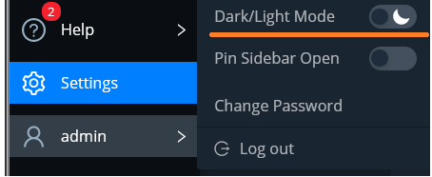
DARK MODE
Notes:
Dark Mode

Slide 9

Getting Started with Cribl Stream
https://cribl.io/stream/
https://sandbox.cribl.io/
https://cribl.io/university/
Cribl Certified Observability Engineer (CCOE)
- CCOE User
- CCOE Admin
Notes:
Image downloaded from https://www.pngall.com/comic-png/download/59539
Main Site
Sandbox – Smaller tutorials; and basic how-to
University -
User - The Cribl Certified Observability Engineer Stream User (CCOE Stream User) is a foundation level certification designed
to introduce, educate and validate the student’s ability to effectively use Cribl’s Stream solution. This includes
deployment options, general Stream components, basic configurations, Pipeline configuration and operation and
best practices.
Admin - Level 2 certification. CCOE Stream Admin extends the knowledge and experience obtained at the CCOE Stream User level by providing in-depth, practically-oriented courses. This certification is meant to prepare individuals to be the Stream expert within their organization or project, and more specifically to ensure that the implementation, management and results of their Stream environment takes place effectively and stands the best chance of success.

Slide 10
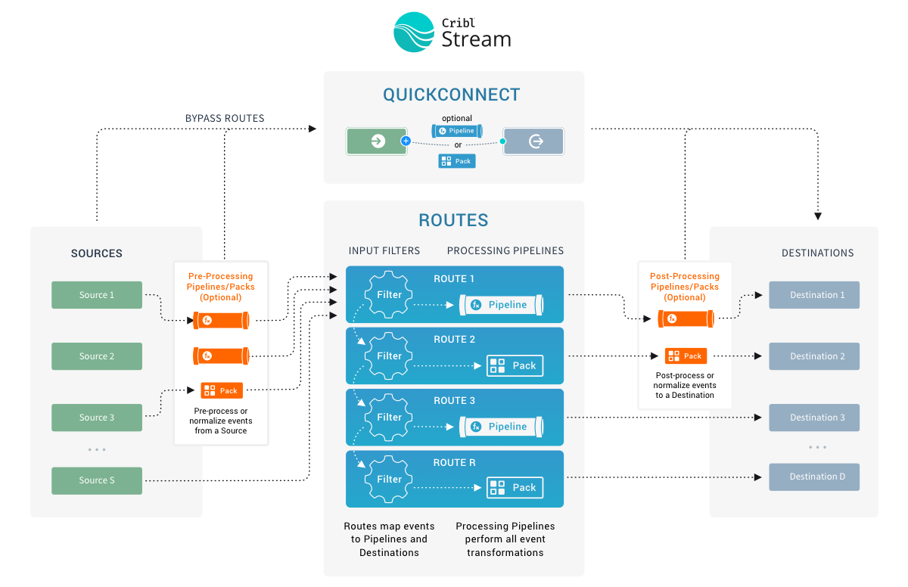
Notes:
Go over the basics of Source -> Routes -> Destinations (and quickconnect) Example; Taking JSON in; but spitting out CSV. OR HEC HTTP event Collector Mention Event Breakers RIGHT AFTER SOURCE! Sampling next slide

Slide 11
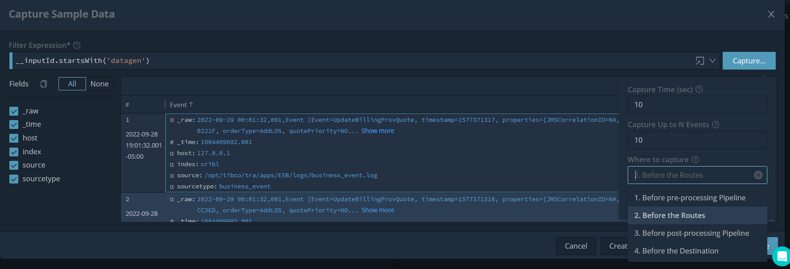
Sample Example
Notes:
Notes to mention Filter on the Input = i.e. specific input or filter down
Note WHERE to Capture
Number of Files/Time
Not Fields; _raw, _time, host, index, source, sourcetype

Slide 12
What about that CIM THING?
Leverage the EVAL function …and more.
Notes:
OH Right; lets dig into that a bit before we go into stuff fully.

Slide 13
GEOIP Enrichment at Ingestion
Knowing IP info and adding it to the data at ingestion is a huge win. (at the costs of space)
Then being able to use EVAL functions to downsize the size of the fields that may show by default. (Or other languages)

Slide 14
Going Deeper and adding Vuln Information
Leveraging Possible Compromised Ips
Using a lookup to compare and “enrich” data on if matched compromised list.

Slide 15
Sound Interesting?
Geoip + ip threat intel enrichment https://sandbox.cribl.io/course/enrichment
Threat Intel with bro Blog by Cribl - https://cribl.io/blog/simple-threat-intelligence-with-cribl-logstream/
Notes:
Blog by Claudio Cruz – does a setup of threat intel and how to seutp enrichment of bro using IP,URL, Hash. Good base to get people started.

Slide 16
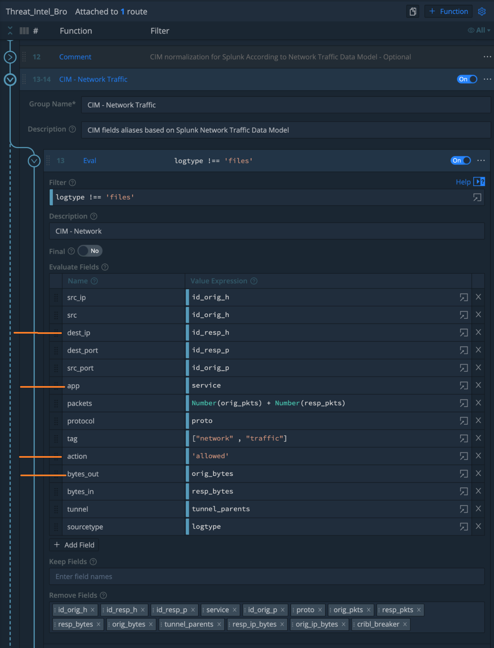
Notes:
Mention this is from the Blog post and go over the fields.

Slide 17
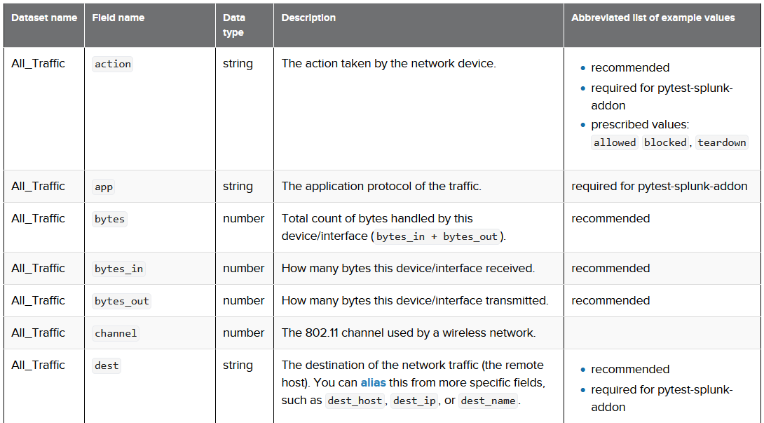

Slide 18
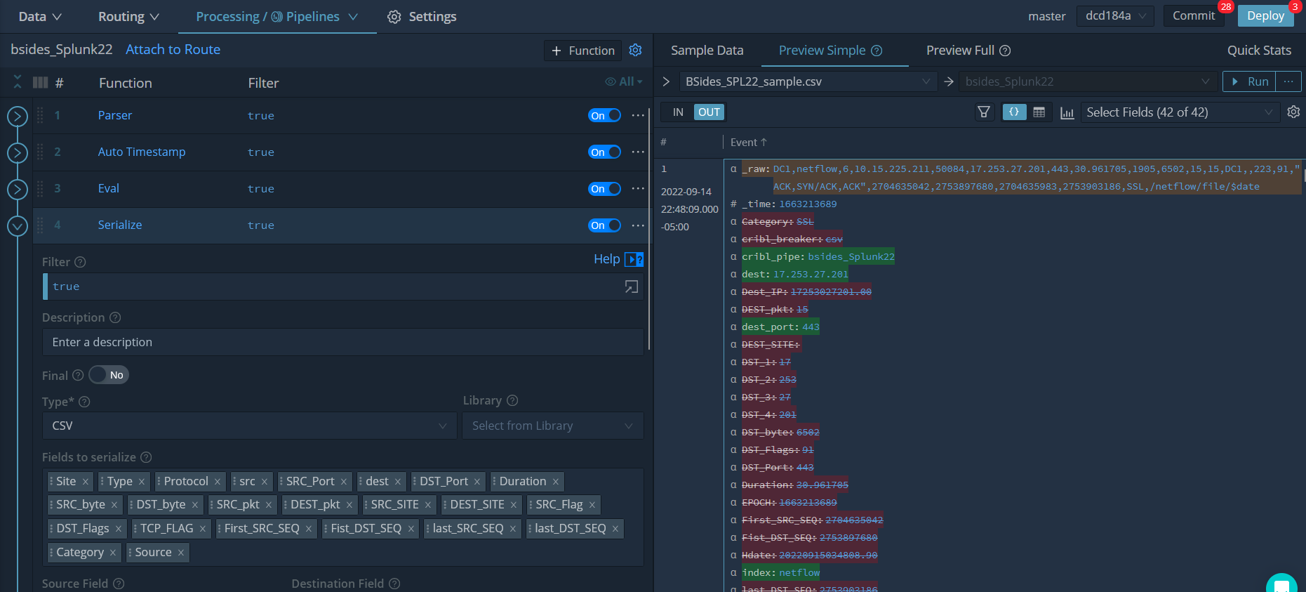
The kinda Unique Story
Place your screenshot here
Notes:
Will most likely add more screen shots here to help with the presentation VS an actual Demo; to help make the presentation “Useful” on its own vs having to watch the video.

Slide 19
A Start of our Ingesiton Setup
CSV Files of Netflow data
Was using Splunk Forwarder and doing index time extractions for all fields.
Switching to Cribl for future enrichment use cases and new streaming sources in the future.

Slide 20
Sample File/Event CSV
36 Fields
EPOCH,Hdate,Site,Type,Protocol,Src_IP,SIP_1,SIP_2,SIP_3,SIP_4,Dest_IP,DST_1,DST_2,DST_3,DST_4,SRC_Port,DST_Port,Duration,SRC_byte,DST_byte,SRC_pkt,DEST_pkt,SRC_SITE,DEST_SITE,SRC_Flag,DST_Flags,TCP_FLAG,First_SRC_SEQ,First_DST_SEQ,last_SRC_SEQ,last_DST_SEQ,Category,Source
1663213689,20220915034808.900,DC1,netflow,6,10015225211,10,15,225,211,17253027201,17,253,27,201,50084,443,30.961705,1905,6502,15,15,DC1,,223,91,"ACK,SYN/ACK,ACK",2704635042,2753897680,2704635983,2753903186,SSL,/netflow/file/$date
BLEH
Notes:
EPOCH,Hdate,Site,Type,Protocol,Src_IP,SIP_1,SIP_2,SIP_3,SIP_4,Dest_IP,DST_1,DST_2,DST_3,DST_4,SRC_Port,DST_Port,Duration,SRC_byte,DST_byte,SRC_pkt,DEST_pkt,SRC_SITE,DEST_SITE,SRC_Flag,DST_Flags,TCP_FLAG,First_SRC_SEQ,Fist_DST_SEQ,last_SRC_SEQ,last_DST_SEQ,Category,Source
1663213689,20220915034808.900,DC1,netflow,6,10015225211,10,15,225,211,17253027201,17,253,27,201,50084,443,30.961705,1905,6502,15,15,DC1,,223,91,"ACK,SYN/ACK,ACK",2704635042,2753897680,2704635983,2753903186,SSL,/netflow/file/$date
1663213688,20220915034808.200,DC1,netflow,6,163123000000,163,123,143,78,10015225138,10,15,225,138,49239,111,0,54,0,1,0,DC1,DC5,2,0,SYN,1156890134,0,1156890134,0,OUTFLOW-SCAN,/netflow/file/$date NOTE – Sanitized AND Smaller than the normal Fields.

Slide 21

So what was the issue?
Indexed ALL the fields
We had VERY HIGH Disk Usage per GB/TB of _raw data. (I.E. 1GB of Data took ~4GB of Data on Disk)
Its netflow (So huge intake/license hit)
One of the primary use cases for Splunk but also a very LARGE ingest.
Structured in a certain way, but not “Splunk Friendly”

Slide 22
No…what is the issue?
There were 3 timestamps on each event. - _time - EPOCH TimeStamp - Human Readable TimeStamp
All IPS were also mentioned multiple times.
One long number
Each IP Segment as a separate Field.
TCP Flags are very verbose for connections. (But required for use cases)

Slide 23
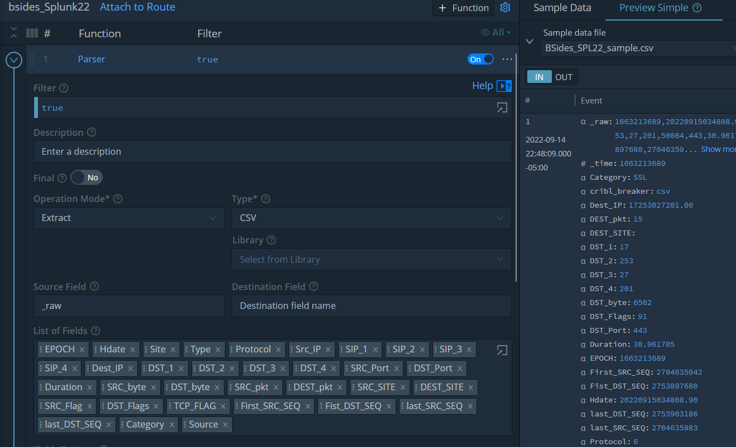
Notes:
Parser Function; To bring in Extract the CSV Files. (Also use an event breaker before hand to be honest)

Slide 24
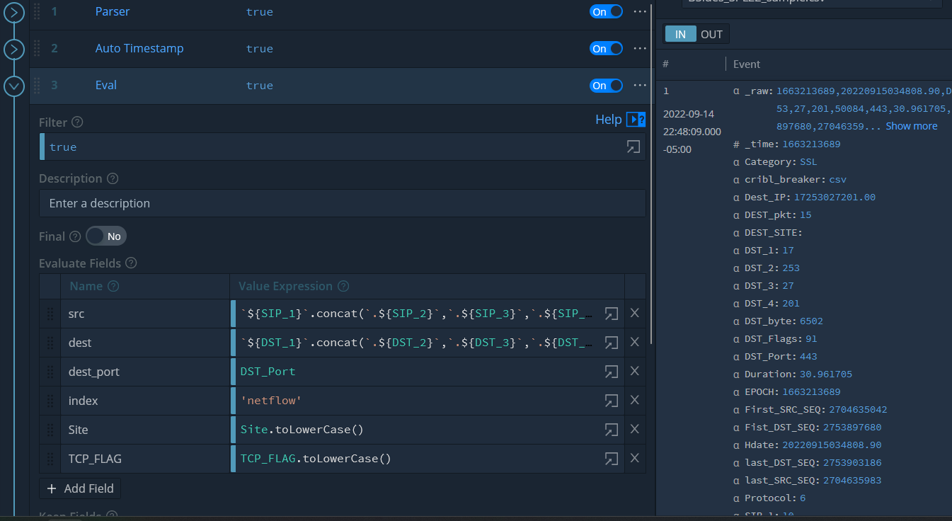
Notes:
Parser Function; To bring in Extract the CSV Files. (Also use an event breaker before hand to be honest)

Slide 25
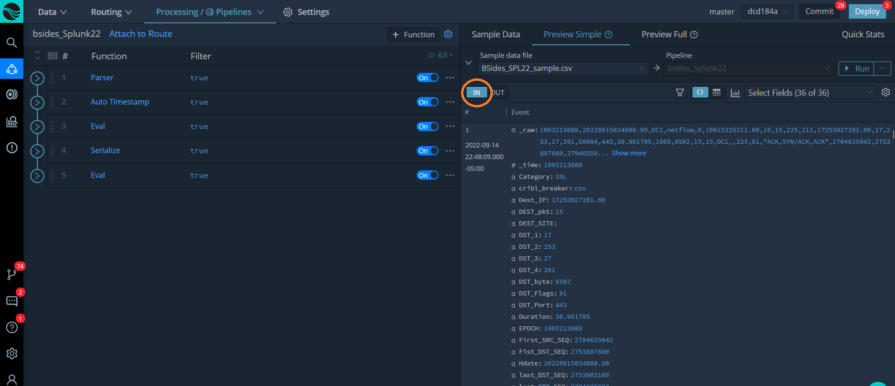
Notes:
Sampling before the changes into the routes.

Slide 26
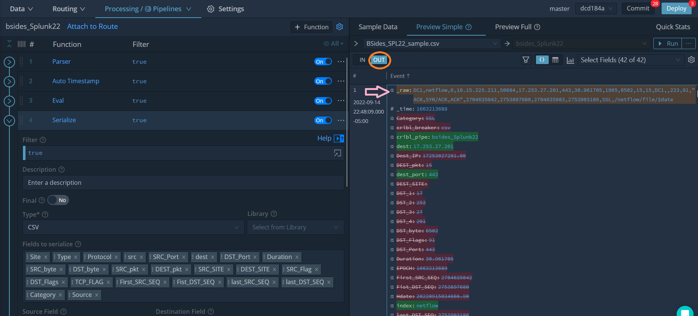
Notes:
Here you can see the greatness of leveraging a sampling.

Slide 27
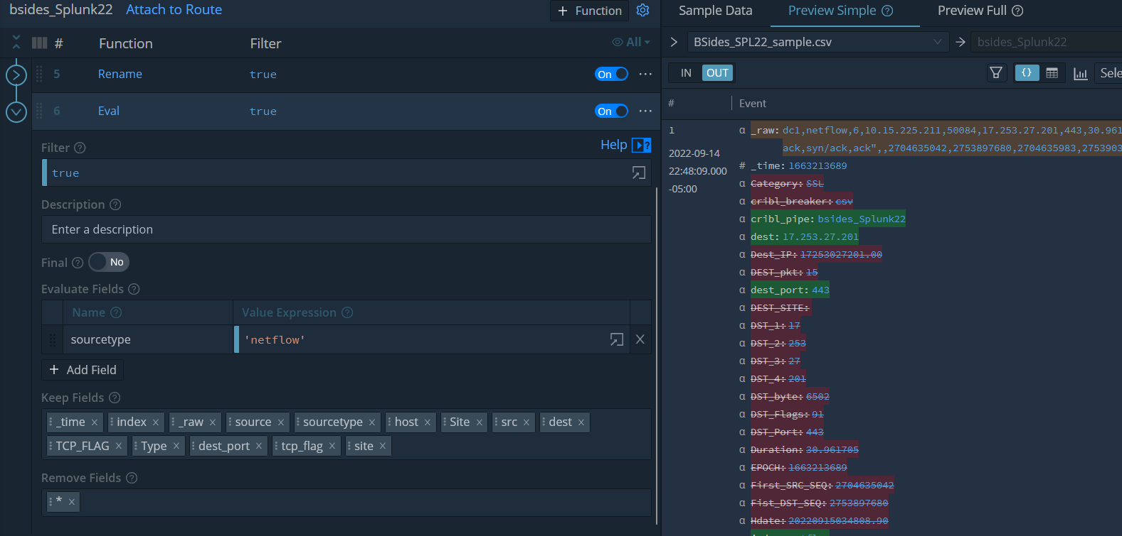
Notes:
Adding sourcetype; but then the fields to keep and remove.

Slide 28
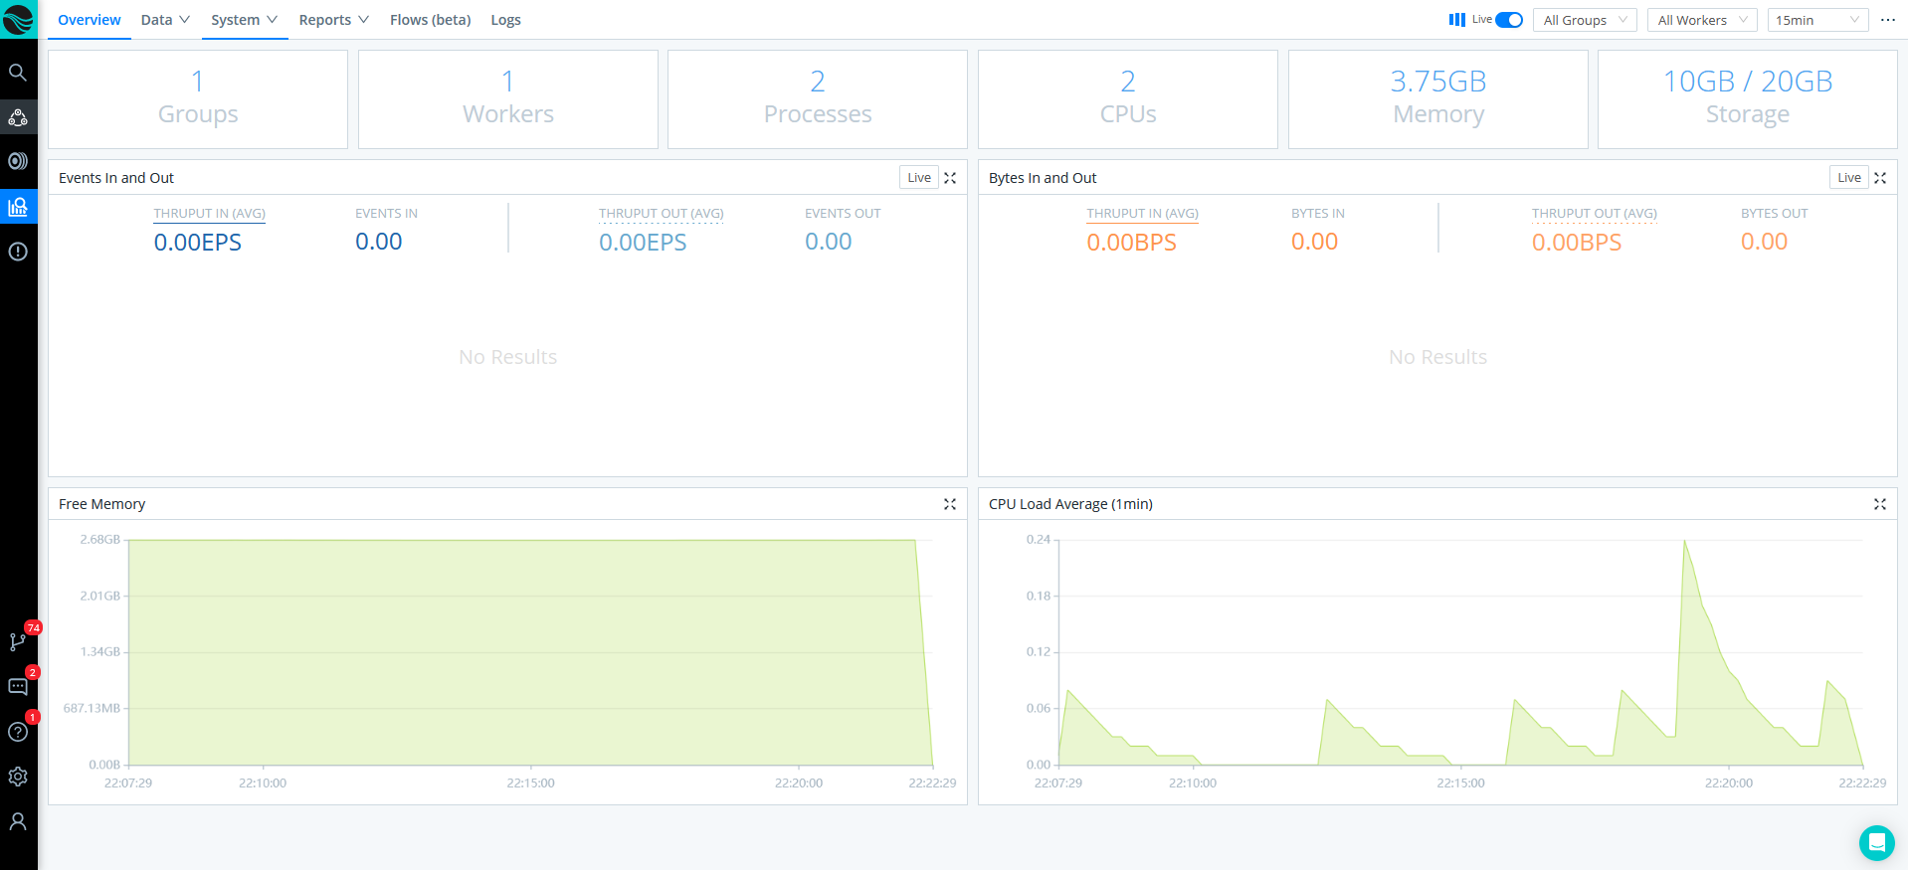
DEMO TIME
Lets go to a Cribl Instance and upload a sample of our file and see how we can mess with it to fix it.
Place your screenshot here
Notes:
Will most likely add more screen shots here to help with the presentation VS an actual Demo; to help make the presentation “Useful” on its own vs having to watch the video.

Slide 29
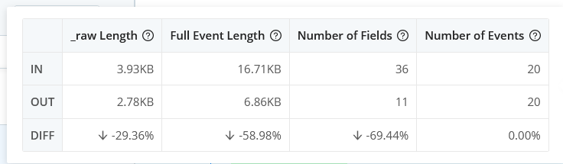
Sample reduction
_raw=Splunk License reduction
Place your screenshot here

Slide 30

53 Fields
Ending with 11 indexed fields
36% Reduction RAW
The Original Culprit
Several with HIGH cardinality
A few with duplicative information
Restructure to be quicker to read
wow
Total success!
Notes:
Image downloaded from https://www.pngall.com/comic-png/download/59491 Remember that a reduction in _raw; helps not only reduce the Splunk License BUT also the disk usage. High Cardinality; IP numbers; epoch timestamps; TCP Flags
Duplicates; again Ips and Timestamps.

Slide 31


Slide 32

THANKS!

